Slide 1
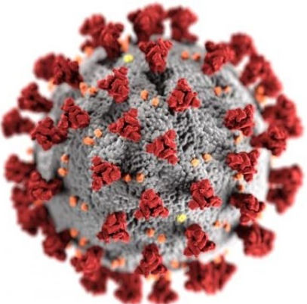
How much do we know about the invisible Enemy?
Clinical Management in Bangladesh
COVID-19
Dr. Quazi Tarikul Islam
Professor of Medicine
Member, National Technical Advisory Committee on COVID-19
prof.tarik@gmail.com

Slide 2
CASE 1
A 69 year old man had 2 days low grade temperature without cough, sore throat and SOB had severe fatigue only passed 7 days at home.
He was checking saturation at home which remains between 95 – 96% so he did not do any investigations. On 9th day of illness he has been investigated for RT-PCR for COVID came negative. On 10th day CRP, Ferritin, LDH, D-dimer and HRCT Lung. All investigations were very high with HRCT chest shows 60 % of lung infiltrates as GGO and crazy paving.
Contd....

Slide 3
CASE 1
He was treated as COVID pneumonia initialy moderate then severe type. Treated with Enoxaparin, Ramdisivir, Antibiotics, Oxygen therapy and Steroid. Oxygen requirement went up to 10-12 liters which came down to 2 liters /min. Patient also got Inj. Tocilizumab 2 shots in 12 hours apart as Ferritin went up to 2000 above. All the parameters of tests came down to normal except D-dimer which remains above 1000ng/ml. Lung shadow reduced to 25%.
Contd....

Slide 4
CASE 1
On 28 days of illness (18 days of treatment) he was put on DOAC and supportive drugs as he is hypertensive, Diabetic and history of PCI. 4 days after the oral drugs all investigations repeated lungs had 30-35% basal shadow with fibrotic changes and persistent high D-dimer. All other tests were normal. The patient stated complaining of more oxygen demand. From 2 liter it increases to 6 liters. HRCT chest done and it was a very bad picture involving 70% of lung. IgG titer for COVID was done came good titer positive.
Contd....

Slide 5
CASE 1
Further he was put on therapeutic dose of Enoxaparin, Steroid, Antifungal (Voriconazole), Antibiotics, Oxygen upto HFNC 40L/min. Sputum shows profuse growth of Klebsiella Pneum. He was deteriorating and at 92% of saturation he was put on Ventilator on 44th day of illness. Vitals were well maintained.
ANA,ENA profile, Anti Scl 70, Anti CCP ab, RA all were negative. On 50th day of illness lung shadow again improved with 30% shadow at base but total count very high. Presently on ventilator.

Slide 6
Case 1
On 10th day on ventilator all parameters of vitals and lab reports were stable and normal with a PEEP of 3. But unfortunately the patient developed bilateral pneumomediastinum. Two drainage tube inserted and tracheostomy done. Antibiogram shows all antibiotics are resistance. Patient developed AKI and put on haemodialysis (SLADE). Today is the 64th day of illness.
?????????????????????????????????????????

Slide 7
CASE 2
A 56 year non diabetic, non hypertensive businesswoman had body ache only on 5th April and did PCR which was positive on 9th April. She was treated symptomatic got well and came back to work after 3 weeks. On 21st May she developed fever, dry cough. On 26th May she got admitted in to hospital and underwent following investigations. CXR, HRCT Lung, CBC,D-dimer, CRP, Ferritin, LDH. All investigations were in favour of COVID so PCR was done and came positive.
Contd....

Slide 8
CASE 2
Enoxaparin, Remdisivir, Steroid, Toclizumab, Oxygen therapy up to HFNC 50L/min failed to improve the clinical situation and was put on Ventilator on 4th June. In 48 hours of mechanical support she developed tachyarrythmia with increased Trop-i level. She developed cardiac arrest twice reversed with cardioversion but third arrest could not be reversed and the patient died.

Slide 9

WE MOURN
Hats Off to The Frontliners

Slide 10
Global: Health workers silenced, exposed and attacked
There is currently no systematic global tracking of how many health and essential workers have died after contracting COVID-19.
However, Amnesty International has collated and analyzed a wide range of available data that shows that over 3000 health workers are known to have died after contracting COVID-19 in 79 countries around the world.
According to Amnesty International’s monitoring, the countries with the highest numbers of health worker deaths thus far include the USA (507), Russia (545), UK (540), including 262 social care workers), Brazil (351), Mexico (248), Italy (188), Egypt (111), Iran (91), Ecuador (82) and Spain (63).
Health workers reported serious shortages of personal protective equipment (PPE) in nearly all of the 63 countries and territories surveyed by Amnesty International.
Amnesty International, July 13, 2020

Slide 11
A doctor working in Mexico City told Amnesty International that doctors were spending about 12% of their monthly salaries buying their own PPE.
In addition to a global shortage of supply, trade restrictions may have aggravated this problem. In June 2020, 56 countries and two trade blocs (the European Union and the Eurasian Economic Union) had put in place measures to either ban or restrict the export of some, or all, forms of PPE or its components.
Amnesty International documented several cases where health and essential workers experienced stigma and violence because of their jobs. For example, a nurse in Mexico was reportedly drenched with chlorine while walking on the street, and in the Philippines, attackers poured bleach in the face of a hospital utility worker.
TAKE ACTION AND ADD YOUR VOICE
Let’s Protect Health and Essential Workers Everywhere in the World
Amnesty International, July 13, 2020

Slide 12
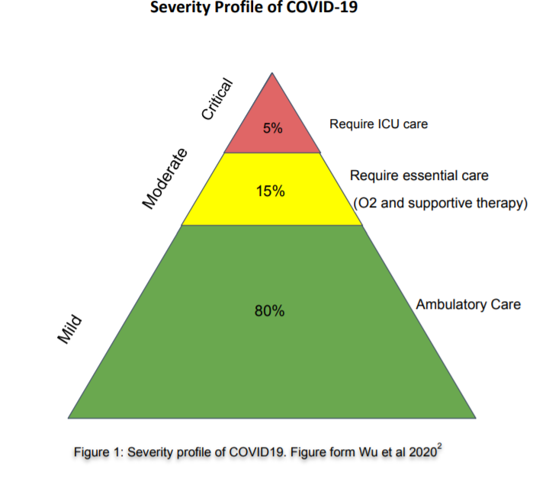

Slide 13

In Bangladesh 1st case was reported on
March 08, 2020
It has already cost thousands of life and is a national burden both in health sector and in economic sector

Slide 14
Bangladesh
As on 24.7.2020
Total Tests : 1,091,034
Total Cases : 218,658
Total Death : 2836 ( 1.3%)
Total Recovered : 120,976

Slide 15
Clinical Presentation

Slide 16
Clinical Features
Cough and shortness of breath or difficulty breathing plus at least 2 may indicate COVID-19 (not always applicable)
Fever Chills Repeated shaking with chills Muscle pain | Headache Sore throat New loss of taste or smell
CDC. Symptoms of Coronavirus. CDC. Available at https://www.cdc.gov/coronavirus/2019-ncov/symptoms-testing/symptoms.html. March 20, 2020; Accessed: April 28, 2020.

Slide 17
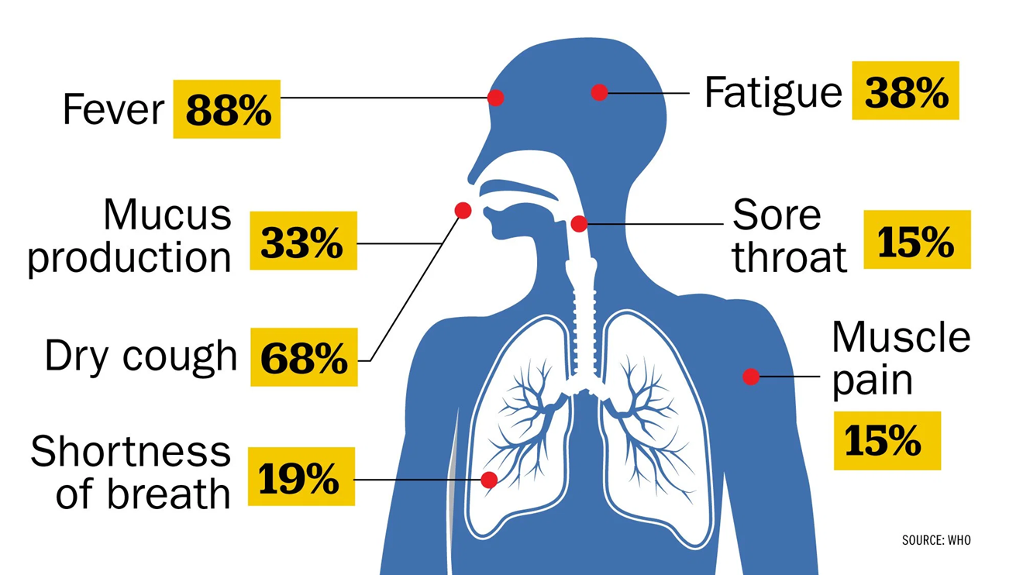
According to a study of nearly 56,000 laboratory confirmed cases cited in the WHO report, the most common symptom, experienced by 88% of confirmed patients, is a fever.

Slide 18
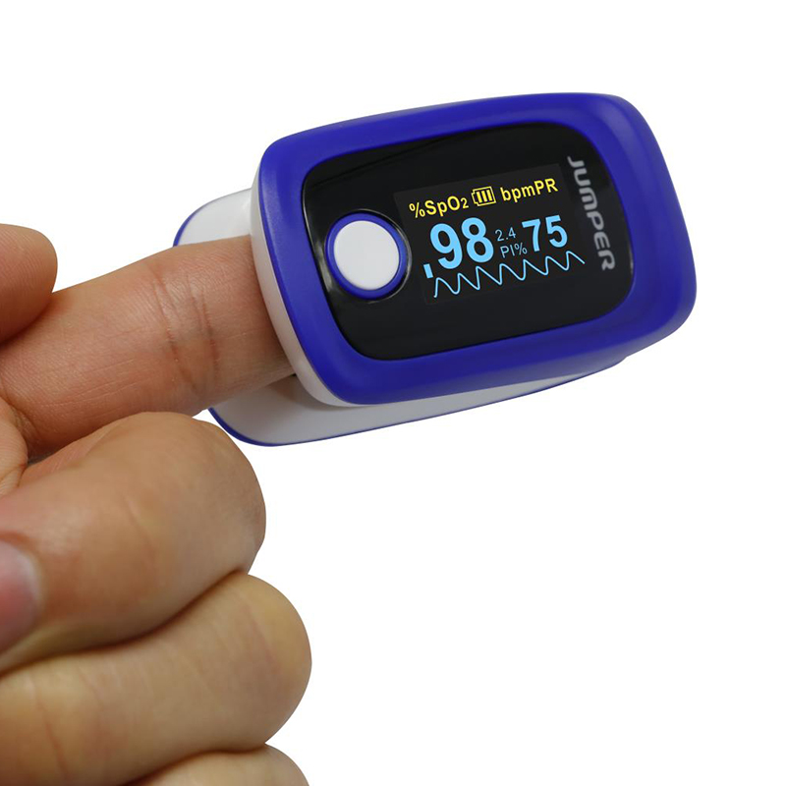
Check at Home
Patient may not feel SOB in the early stage of the disease though there is hypoxia- known as Happy Hypoxia.
Those who could not be diagnosed between 8-10 days that they have bi lateral lung infiltrates, their course of the disease and prognosis goes worst.
These group of patients proceeds to Severe /Critical.

Slide 19
Disease Manifestations
Asymptomatic (5%-80%)¹ In USA 40% ( The Mirror, 13 June)
Presymptomatic^{2,3}
  - Initially asymptomatic (1-3 days), later develops symptoms
  - Accounts for 6%-12% disease transmission
  - To prevent transmission, limiting contacts may not be enough
  - Supports social distancing, wearing surgical masks at population level.
Symptomatic
1. https://www.cebm.net/covid-19/covid-19-what-proportion-are-asymptomatic/
2. Wei WE, et al. MMWR Morb Mortal Wkly Rep. 2020 Apr 1. doi: 10.15585/mmwr.mm6914e1
3. Qian G, et al. Clin Infect Dis2020;ciaa316. doi:10.1093/cid/ciaa316

Slide 20
Spectrum of Clinical Syndromes
Associated with COVID-19 Infection
Mild illness(ILI)
Pneumonia (Moderate)
Severe Pneumonia
Acute Respiratory Distress Syndrome
Sepsis
Septic shock

Slide 21
Clinical Classification
Critical cases
Severe cases
Moderate cases
Mild
cases
Cases meeting any of the following criteria:
Fever and respiratory symptoms with radiological findings of pneumonia
The clinical symptoms are mild, and there is no sign of pneumonia on imaging
Fever and respiratory symptoms with radiological findings of pneumonia.
Respiratory failure and requiring mechanical ventilation
Respiratory distress with > 30 breaths /min
Symptoms may be: fever, cough, sore throat, malaise, headache, muscle pain without shortness of breath or abnormal imaging
Respiratory distress with < 30 breaths /min
Shock
Pulse oxymetry showing saturation < 93% at ambient air
With other organ failure that requires ICU care
Pulse oxymetry showing saturation
> 93% at ambient air

Slide 22
High-Risk Features
Age ≥65 years
Nursing home or long-term care facility resident
Cardiac: Heart disease with complications
Immunocompromised: Including cancer treatment
Severe obesity: BMI ≥40
High risk Pregnancy
Comorbidities: Diabetes, renal failure, liver disease, HTN
Centre for Disease Control, USA

Slide 23
Acute Respiratory Distress Syndrome (ARDS)
Acute onset (within 1 week)
Bilateral opacities on chest imaging (e.g., x-ray)
Impaired oxygenation: PaO₂/FiO₂ ≤300 mmHg
If no risk factors for ARDS, acute left ventricular failure should be ruled out.
ARDS Definition Task Force, Ranieri VM, et al. JAMA. 2012 Jun 20;307(23):2526-33.

Slide 24
ARDS: When to suspect?
Critically ill patient if having…..
              - Dyspnoea, tachypnoea but
              - Chest auscultation normal.
Udobi KF, et al. Am Fam Physician. 2003 Jan 15;67(2):315-22.

Slide 25
Septic Shock
Persisting hypotension despite volume resuscitation, requiring vasopressors to maintain MAP ≥65 mmHg and
Serum lactate level >2 mmol/L persisting after adequate fluid resuscitation. Needs Ventilator Support
Shankar-Hari M, et al., Sepsis Definitions Task Force. JAMA. 2016 Feb 23; 315(8):775-87.

Slide 26
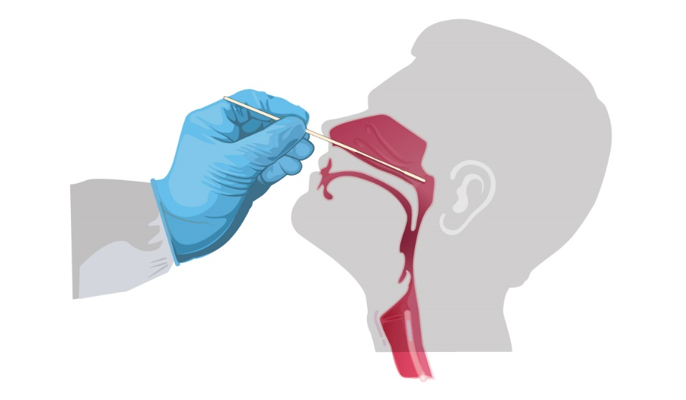
Investigations

Slide 27
Real-time RT-PCR Test for SARS-CoV-2
All suspects should have RT-PCR
Gold standard
High specificity, low sensitivity (65-95%)
Specimen:
  Upper airway specimens: Nasopharyngeal swab (first choice), oropharyngeal swab
  Lower airway specimens: Bronchoalveolar lavage, tracheal aspirate, pleural fluid, lung biopsy, sputum

Slide 28
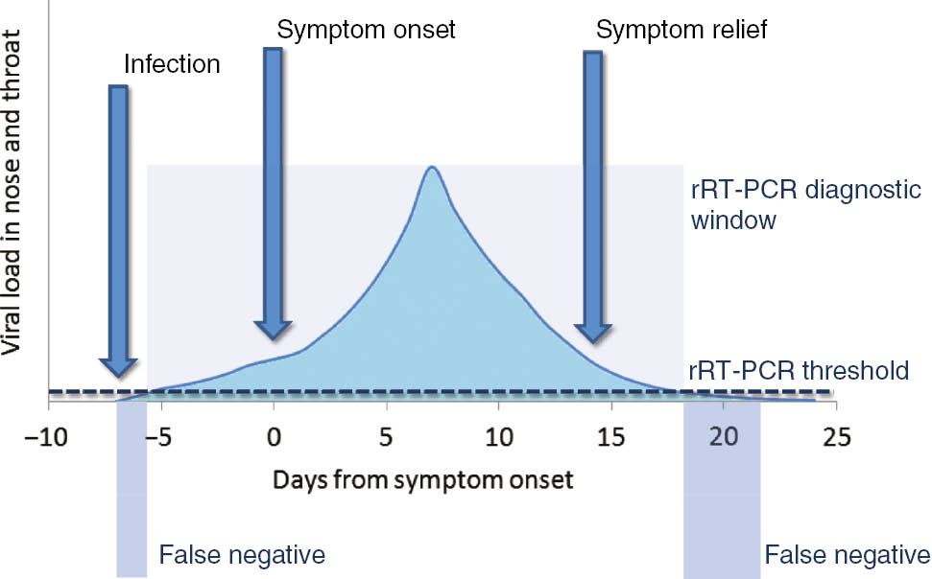
RT-PCR for SARS-CoV-2
Correspondence between viral load,
disease progression and RT-PCR
RT-PCR in 56 confirmed COVID- 19
patients in China
Week | Positivity
1 | 100%
2 | 89.3%
3 | 66.1%
4 | 32.1%
5 | 5.4%
6 | 0%
Xiao AT et al. Clin Infect Dis. 2020 Apr 19. pii: ciaa460. doi: 10.1093/cid/ciaa460.
Lippi G, et al. Clin Chem Lab Med. 2020 Mar 16. pii: /j/cclm.ahead-of-print/cclm-2020-0285/cclm-2020-0285.xml.

Slide 29
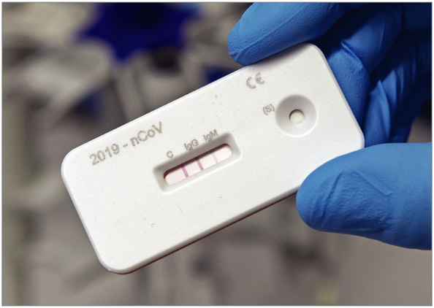
Serological Tests for SARS-CoV-2
Still evolving
Low sensitivity, good specificity
Still not recommended by WHO
CDC, USA has granted EUA
May be important for sero-surveillance
Gonoshasthaya's Rapid Dot Blot testing kit is under trial by ICDDR,B

Slide 30
Other Investigations
Blood tests:
  CBC: Lymphopenia;
  N:L >3.5 bad prognosis
  CRP: Raised
  Serum procalcitonin: Normal
  Serum ferritin: Raised
  Serum LDH: Mildly raised
  Serum D-dimer: Raised
Imaging: Atypical pneumonia
          Chest x-ray
          HRCT scan of chest
          USG of chest
Serological tests for SARS-CoV-2
          Still evolving
Viral culture

Slide 31
CT Scan of Chest
Should not be relied upon for diagnosis and screening
High sensitivity (94%) but low specificity (37%)
Commonest: Ground-glass opacities -- bilateral, subpleural, peripheral
Others:
  Crazy paving appearance (ground-glass opacities plus inter-/intra-lobular septal thickening)
  Consolidation
  Vascular dilatation
  Traction Bronchiectasis
  Subpleural bands and architectural distortion
https://radiologyassistant.nl/chest/lk-jg-1

Slide 32
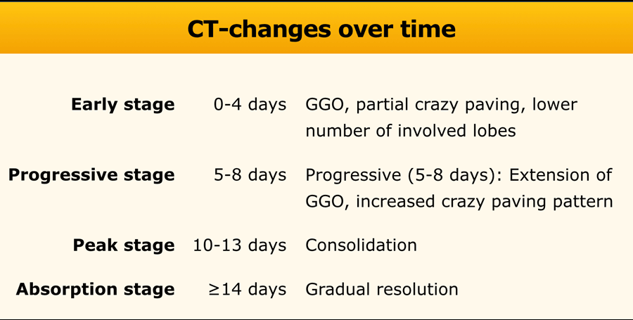
https://radiologyassistant.nl/chest/lk-jg-1

Slide 33
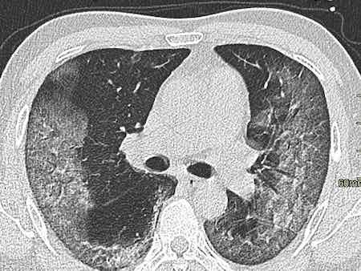
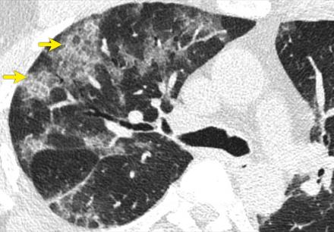
CT scan of chest in COVID- 19
Ground glass opacity
Crazy paving
https://radiologyassistant.nl/chest/lk-jg-1

Slide 34
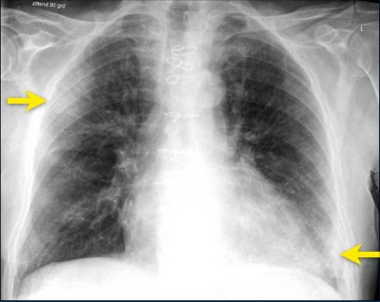
Chest x-ray
Typically, first-line imaging modality
Less sensitive than CT scan of chest
Commonest: Consolidation
Less common: Ground glass opacity
Bilateral, peripheral, lower zone predominant
Pleural effusion rare.
Ground-glass opacification and consolidation in
right upper lobe and left lower lobe (arrows).
https://radiologyassistant.nl/chest/lk-jg-1

Slide 35
Chest x-ray in COVID- 19
Bilateral pneumonia
ARDS
National Guidelines on Clinical Management of Coronavirus Disease 2019(Covid-19), Version 7 28 May, 2020, Government of the People's Republic of Bangladesh.

Slide 36
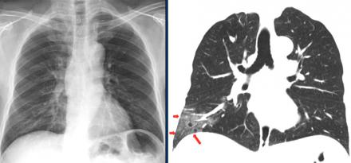
CXR vs. CT scan of Chest
Ground glass opacities in right lower lobe on CT (red arrows) are not
visible on chest radiograph, which was taken 1 hour prior to CT-study.
https://radiologyassistant.nl/chest/lk-jg-1

Slide 37
Management

Slide 38
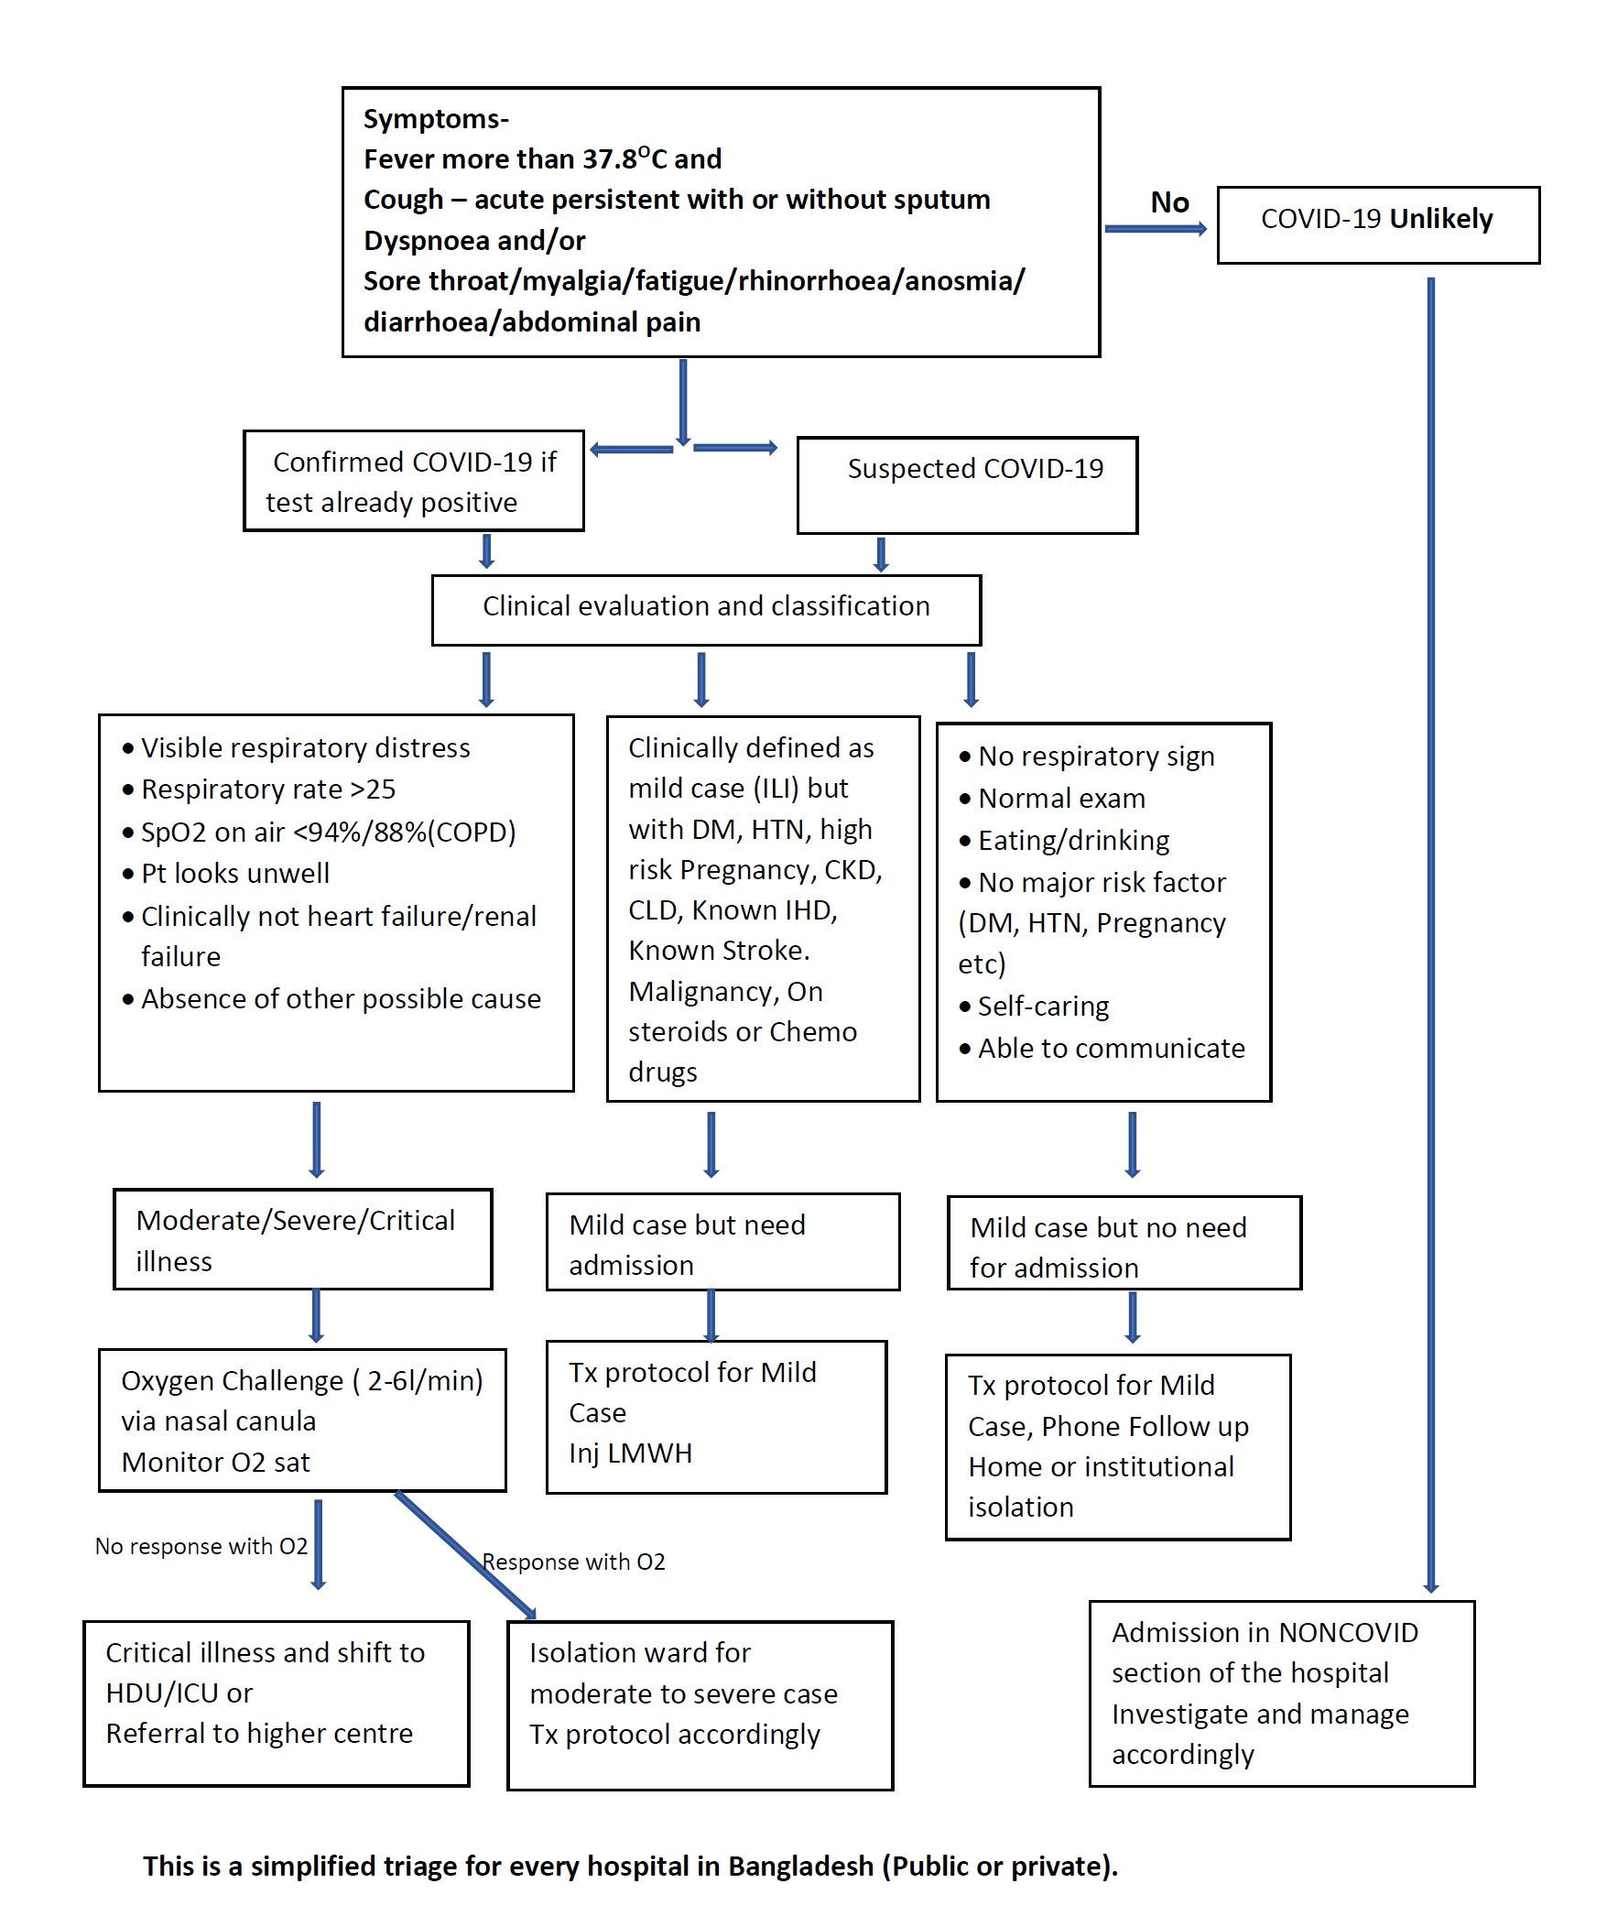
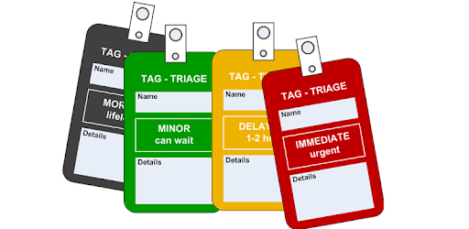
TRIAGE

Slide 39
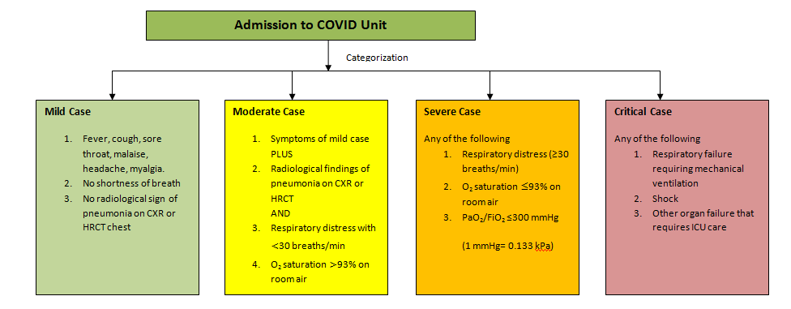
Admission to COVID Unit

Slide 40
Home Patient Management
Home care may be suitable for selected patients; asymptomatic and cases with mild illness (with out risk factor &/or comorbidity) unless there is concern about rapid deterioration or an inability to promptly return to hospital if necessary.

Slide 41
No specific treatment
Management mostly symptomatic & supportive

Slide 42
Clinical Criteria for Case Management
Stage of illness | Definition
Mild | Influenza like illness (ILI)
Moderate | Pneumonia (CRB 65 score 0)
Severe | Severe pneumonia, sepsis
Critical | ARDS, septic shock

Slide 43
Where to Manage?
Stage of Illness | Definition | Place of Care
Asymptomatic | No symptoms | Home, ?Tele- medicine
Mild | Influenza like illness (ILI) | Home
Moderate | Pneumonia (CRB 65 score 0) | Home
Severe | Severe pneumonia, sepsis | Hospital, preferably, HDU
Critical | ARDS, septic shock | Hospital, preferably, ICU

Slide 44
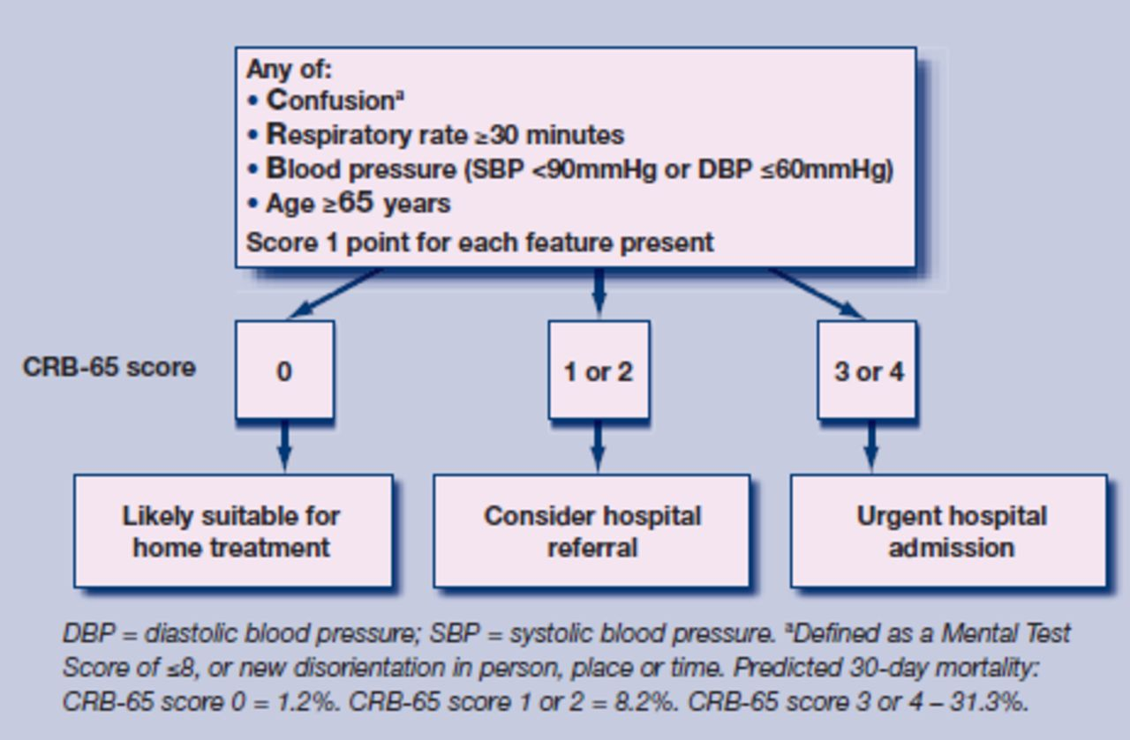
CRB 65 Scoring System

Slide 45
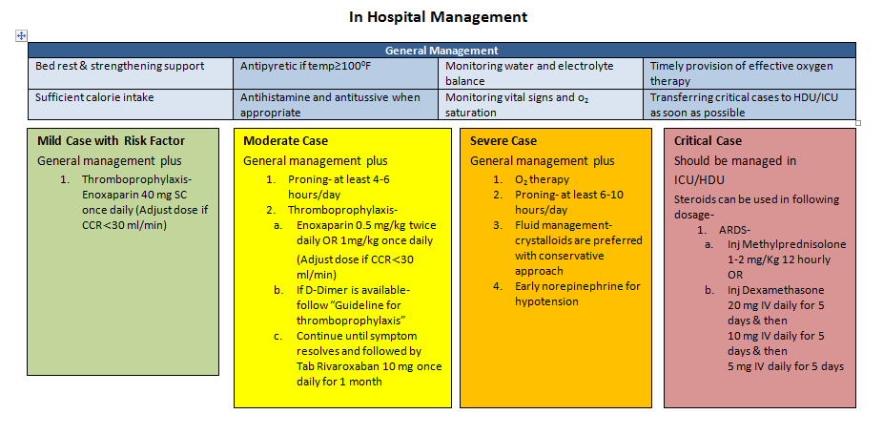
In Hospital Management

Slide 46
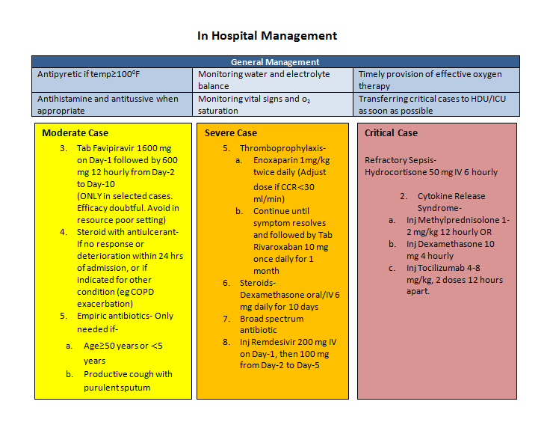
In Hospital Management

Slide 47
Mild cases (Influenza-like illness)
Self-isolation at home (if not possible, institutional isolation)
Symptomatic treatment: Paracetamol, antihistamine
Azithromycin-500 mg once on D1, then 250 mg on D2 to D5.

Slide 48
Self-home isolation for 14 days after clinical recovery
When to seek hospital care?
              Respiratory distress
              Worsening cough and fever
              Altered mental status
              Extreme lethargy

Slide 49
Moderate Cases (Pneumonia)
Treatment as for mild cases
PLUS
Thromboprophylaxis with LMW heparin ( 1 mg/kg BW)
Oral antibiotics as for uncomplicated community acquired pneumonia
Favipiravir 1600 mg stat, 600 mg bd 7-10 days. Efficacy doubtful?
DOAC – Rivaroxavan 10 – 20 mg/ day 2 -4 weeks

Slide 50
Severe Cases (Severe Pneumonia, Sepsis)
Supplemental oxygen:
        If SpO₂ <93%; respiratory rate >30/minute; shock
        Oxygen at 5 litres/min, titrated to target SpO₂ >94%
Thromboprophylaxis with LMW heparin ( 1 mg/kg BW bd)
Inj. Dexamethxsone 20 mg/day 5 days then 10 mg/day 5 days
Empirical antibiotics Injectables
Inj.. Ramdisivir 200 mgstat, 100 mg daily -5 days
Management of co-morbid conditions

Slide 51
Critical Cases (ARDS, Septic shock)
Ventilation:
  Immediate supplemental oxygen, if SpO₂ <94%; high flow nasal canula preferable
  Mechanical ventilation in prone position
Haemodynamic support: Target MAP of 60-65 mmHg.
  Conservative fluid strategy, crystalloids preferable
  Inotropes: norepinephrine (first line), vasopressin (second line)
Thromboprophylaxis with LMW heparin ( Full dose- 14 days)
Empirical antibiotics
Steroid, if septic shock, ARDS ( Inj. Dexamethasone 10 -20 mg/d)

Slide 52
COVID patient’s Oxygen Delivery Algorithm
Aim: SpO2 90-96%%
Device: Nasal prongs/ Face mask/ NRB Mask
Starts oxygen 2-6 l/min through nasal prongs
Asses response for 10-15min to keep Spo2 >90%
If increasing respiratory distress
or SpO2 < 90% (88% in COPD)
Starts oxygen 6-10 l/min through Face mask
Asses response for 10-15min to keep Spo2 >90%

Slide 53
If increasing respiratory distress or SpO2 <90% (<88% in COPD)
Start Proning breathing along with supplement oxygen 10-15 l/min through Face mask/NRB mask
Asses response for 10-15min to keep Spo2 >90%
If still increasing respiratory distress
or SpO2 <90% (<88% in COPD)
or patient is exhausted HFNC is urgently needed ( 40 -50L) /minute, if all these fail only then
Refer the patient to ICU for Ventilator assistance

Slide 54
Available Drug Treatment
Favipiravir: Available ( ? doubtful efficacy)
Remdesivir: FDA approved (available & in use in Bangladesh)
Convalescent plasma ( In use)
Tocilizumab ( specific indication of use) CSS

Slide 55
Bangladesh

Slide 56
Real Life Clinical Experience
Clinical Profile of 100 Confirmed COVID-19 Patients Admitted in
Dhaka Medical College Hospital, Dhaka, Bangladesh
Study Type : Retrospective cross-sectional study
Duration : 02.05.20-15.05.20
Participant No. : 100
Mowla SGM, Azad KAK , Kabir A, Biswas S, Islam MR, Banik GC, Khan MMR, Rohan KMI, Alam MA . Clinical Profile of 100 Confirmed COVID-19 Patients Admitted in Dhaka Medical College Hospital, Dhaka, Bangladesh; J BCPS: vol:38 (spl issue), 2020

Slide 57
Sociodemographic Variables & Mortality
Mean 41.67
Std. Deviation 16.259
Minimum 15
Maximum 85

Slide 58
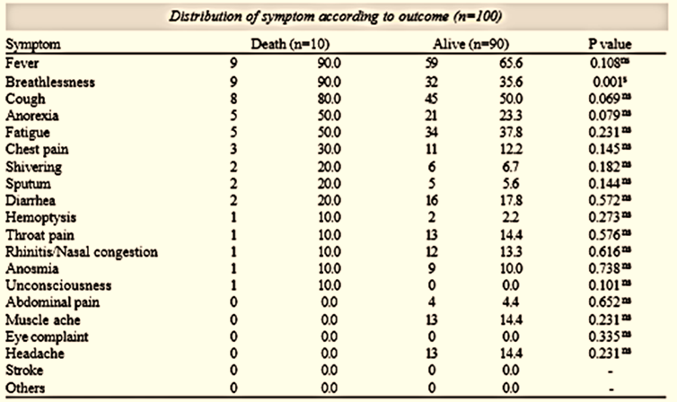
Symptoms & Comorbidities

Slide 59
Multivariate logistic regression analysis of risk factors associated with outcome

Slide 60
DEATH= 10
Age (years) Number
15 – 20 0
21 – 30 1
31 – 40 0
41 - 50 2
51 – 60 1
61 - 70 2
> 70 4
Sex
Male 10
Female 0

Slide 61
Data Analysis of COVID 19 Cases in 3 Hospitals, N-236
Dhaka Medical College Hospital ( DMCH)
Popular Medical College Hospital ( PMCH)
Kuwait Bangladesh Moitry Hospital ( KBMH)

Slide 62
Distribution of Patients according to Age (All 3 Hospitals; N-236)

Slide 63
Distribution of Patients according to Age (Individual Hospitals)

Slide 64
Distribution of Patients according to Gender in Percentage

Slide 65
Symptoms of Patients (All 3 Hospitals; N-236)
Islam QT, Hossain HT, Fahim FR, Rashid M , Clinico-demograhic profile, treatment outline and clinical outcome of 236 confirmed hospitalized covid- 19 patients: a multi-centered descriptive study in dhaka, bangladesh; bjm 31:2,2020

Slide 66
Symptoms of Patients (Individual Hospitals)

Slide 67
Comorbidities of Patients (All 3 Hospitals; N-236)

Slide 68
Comorbidities of Patients (Individual Hospitals)

Slide 69
Treatment Provided (All 3 Hospitals; N-236)

Slide 70
Treatment Provided (Individual Hospitals)

Slide 71
ICU (All 3 Hospitals; N-236)

Slide 72
Outcome (All 3 Hospitals; N-236)

Slide 73
Outcome (Individual Hospitals)
Popular MCH
DMCH
Kuwait MH – 100%

Slide 74
Duration of Hospitalization (All 3 Hospitals; N-236)

Slide 75
Duration of Hospitalization (Individual Hospitals)

Slide 76
Acknowledgement
Dr. Md. Alimur Reza, Manager Medical Affair, BPL
Dr. Faizur Rahman Fahim, Asstt. Prof. of Medicine, DMCH
Dr. Mamun Or Rashid, Consultant Physician, KBMH, Dhaka
Dr. Sadia Halima, Asst. Registrar Medicine, PMCH
Dr. Quazi Audry Rahman, Asst. Registrar Medicine , PMCH
Dr. K M Ashik Elahi, Sr. Executive(DMA), BPL

Slide 77

Published Clinical Trial
RAMDESIVIR

Slide 78
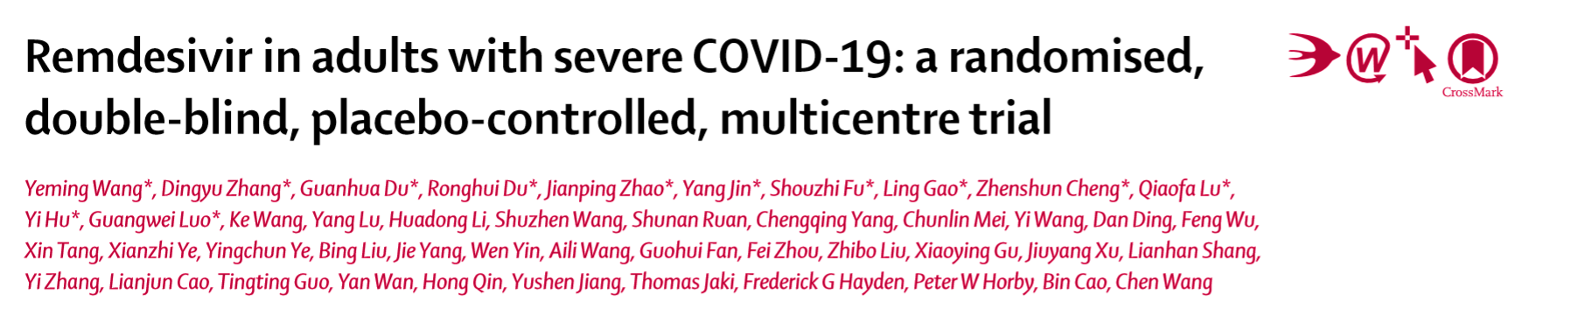
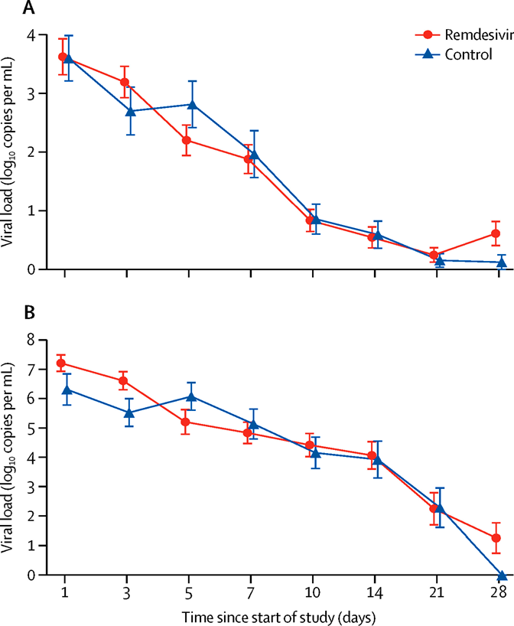

Between Feb 6, 2020, and March 12, 2020, 237 patients were enrolled and randomly assigned to a treatment group (158 to Remdesivir and 79 to placebo).
Although not statistically significant, patients receiving Remdesivir had a numerically faster time to clinical improvement than those receiving placebo among patients with symptom duration of 10 days or less.
Intravenous Remdesivir was adequately tolerated.

Slide 79
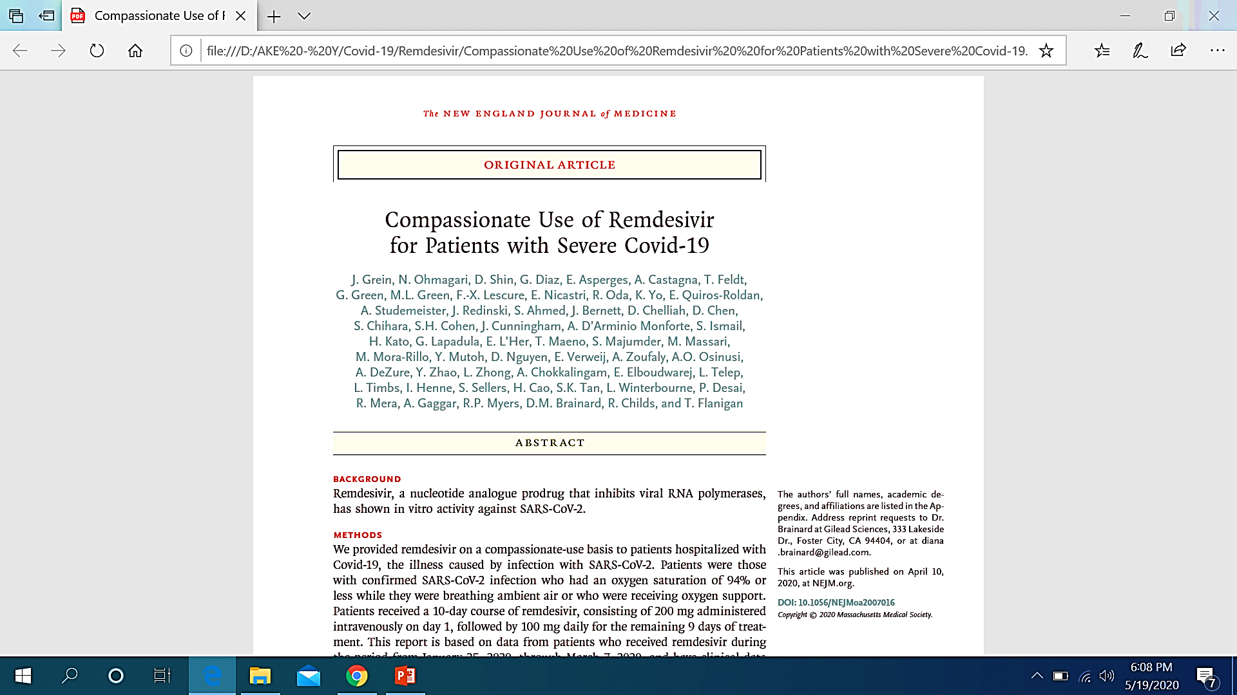
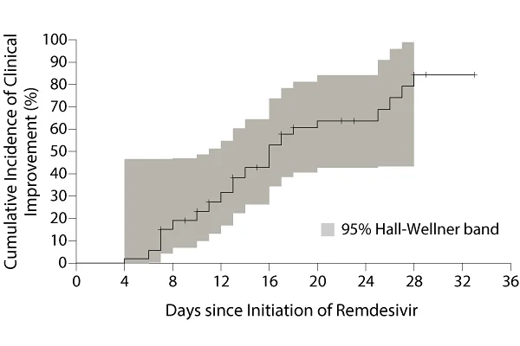
The study was published April 10 in the New England Journal of Medicine .
Of the 53 patients included in the study, 22 were in the United States, 22 were in Europe or Canada, and 9 were in Japan.
Patients received a 10-day course of remdesivir, consisting of 200 mg administered intravenously on day 1, followed by 100 mg daily for the remaining 9 days of treatment.
68% of severely ill patients with COVID-19 who were given Remdesivir for "compassionate use" improved after receiving the medication.

Slide 80
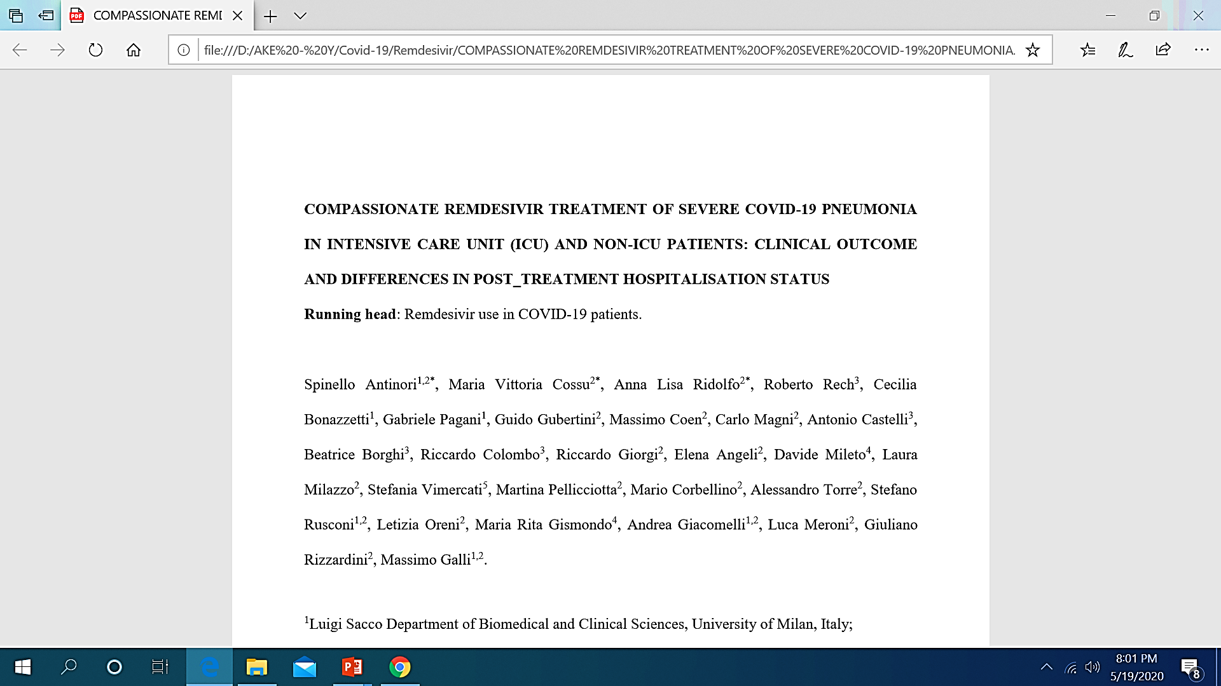
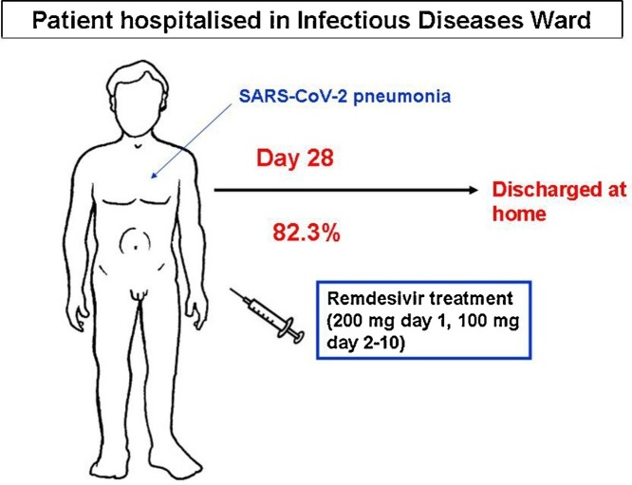
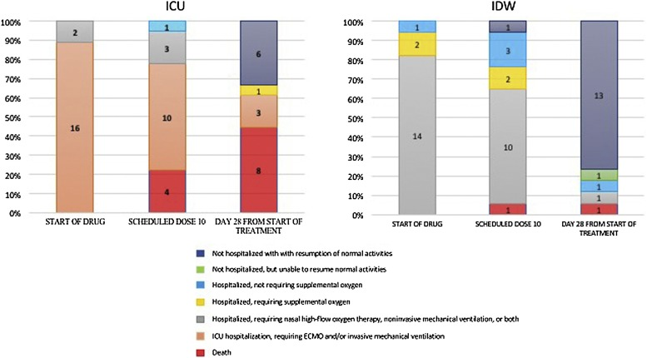
The 35 patients enrolled from February 23 to March 20, 2020, included 18 in intensive care unit (ICU), and 17 in our infectious diseases ward (IDW)
At day 28, 14 (82.3%) patients from IDW were discharged, two were still hospitalized and one died (5.9%)
In ICU 6 (33.3%) were discharged, 8 (44.4%) patients died, three (16.7%) were still mechanically ventilated and one (5.6%) was improved but still hospitalized
The 10-day course of Remdesivir was completed by 22 patients (63%) and discontinued by 13, of whom 8 (22.8%) discontinued because of adverse events
Hypertransaminasemia and acute kidney injury were the most frequent severe adverse events observed (42.8% and 22.8% of the cases, respectively)

Slide 81
Results From Phase 3 Trial of Investigational Antiviral Remdesivir in Patients With Severe COVID-19
 | 5-Day RDV | 10-Day RDV | Baseline adjusted
 | n=200 | n=197 | p-value¹
Clinical Efficacy Outcomes at Day 14
≥ 2-point improvement in ordinal scale | 129 (65) | 107 (54) | 0.16
Clinical recovery | 129 (65) | 106 (54) | 0.17
Discharge | 120 (60) | 103 (52) | 0.44
Death | 16 (8) | 21 (11) | 0.70
Safety
Any adverse event (AE) | 141 (71) | 145 (74) | 0.86
Grade ≥3 study drug-related AE | 8 (4) | 10 (5) | 0.65
Study drug-related serious adverse event (SAE) | 3 (2) | 4 (2) | 0.73
AE leading to discontinuation | 9 (5) | 20 (10) | 0.07

Slide 82

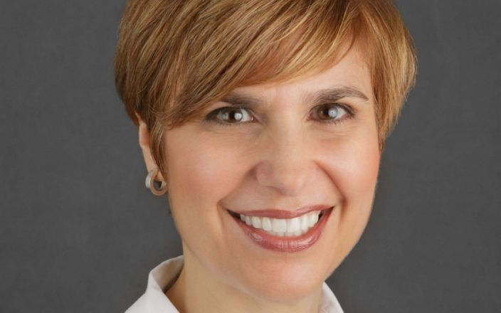
COVID- 19 and Mental Health
A medical worker is seen sitting in the East Village of China during the coronavirus pandemic
Dr. Lorna M. Breen, medical director at NewYork-Presbyterian Allen Hospital, committed suicide.

Slide 83


Slide 84
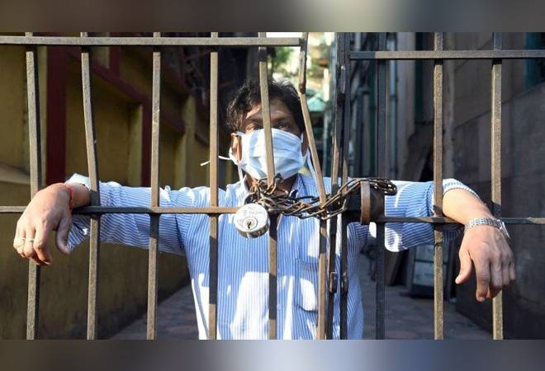

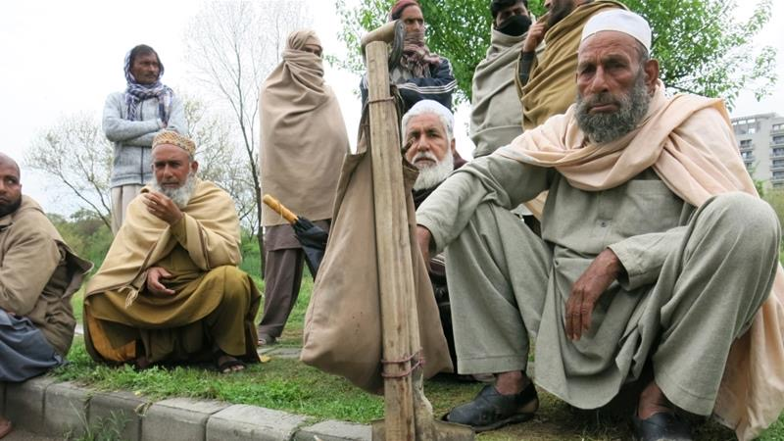

Thank you

